Slide 1
Representation Learning with Contrastive Predictive Coding
Aaron van den Oord, Yazhe Li, Oriol Vinyals
Presented by Lecheng Zheng

Slide 2
Outline
Introduction
Background
Motivation
Proposed Method
Experiment
Conclusion

Slide 3
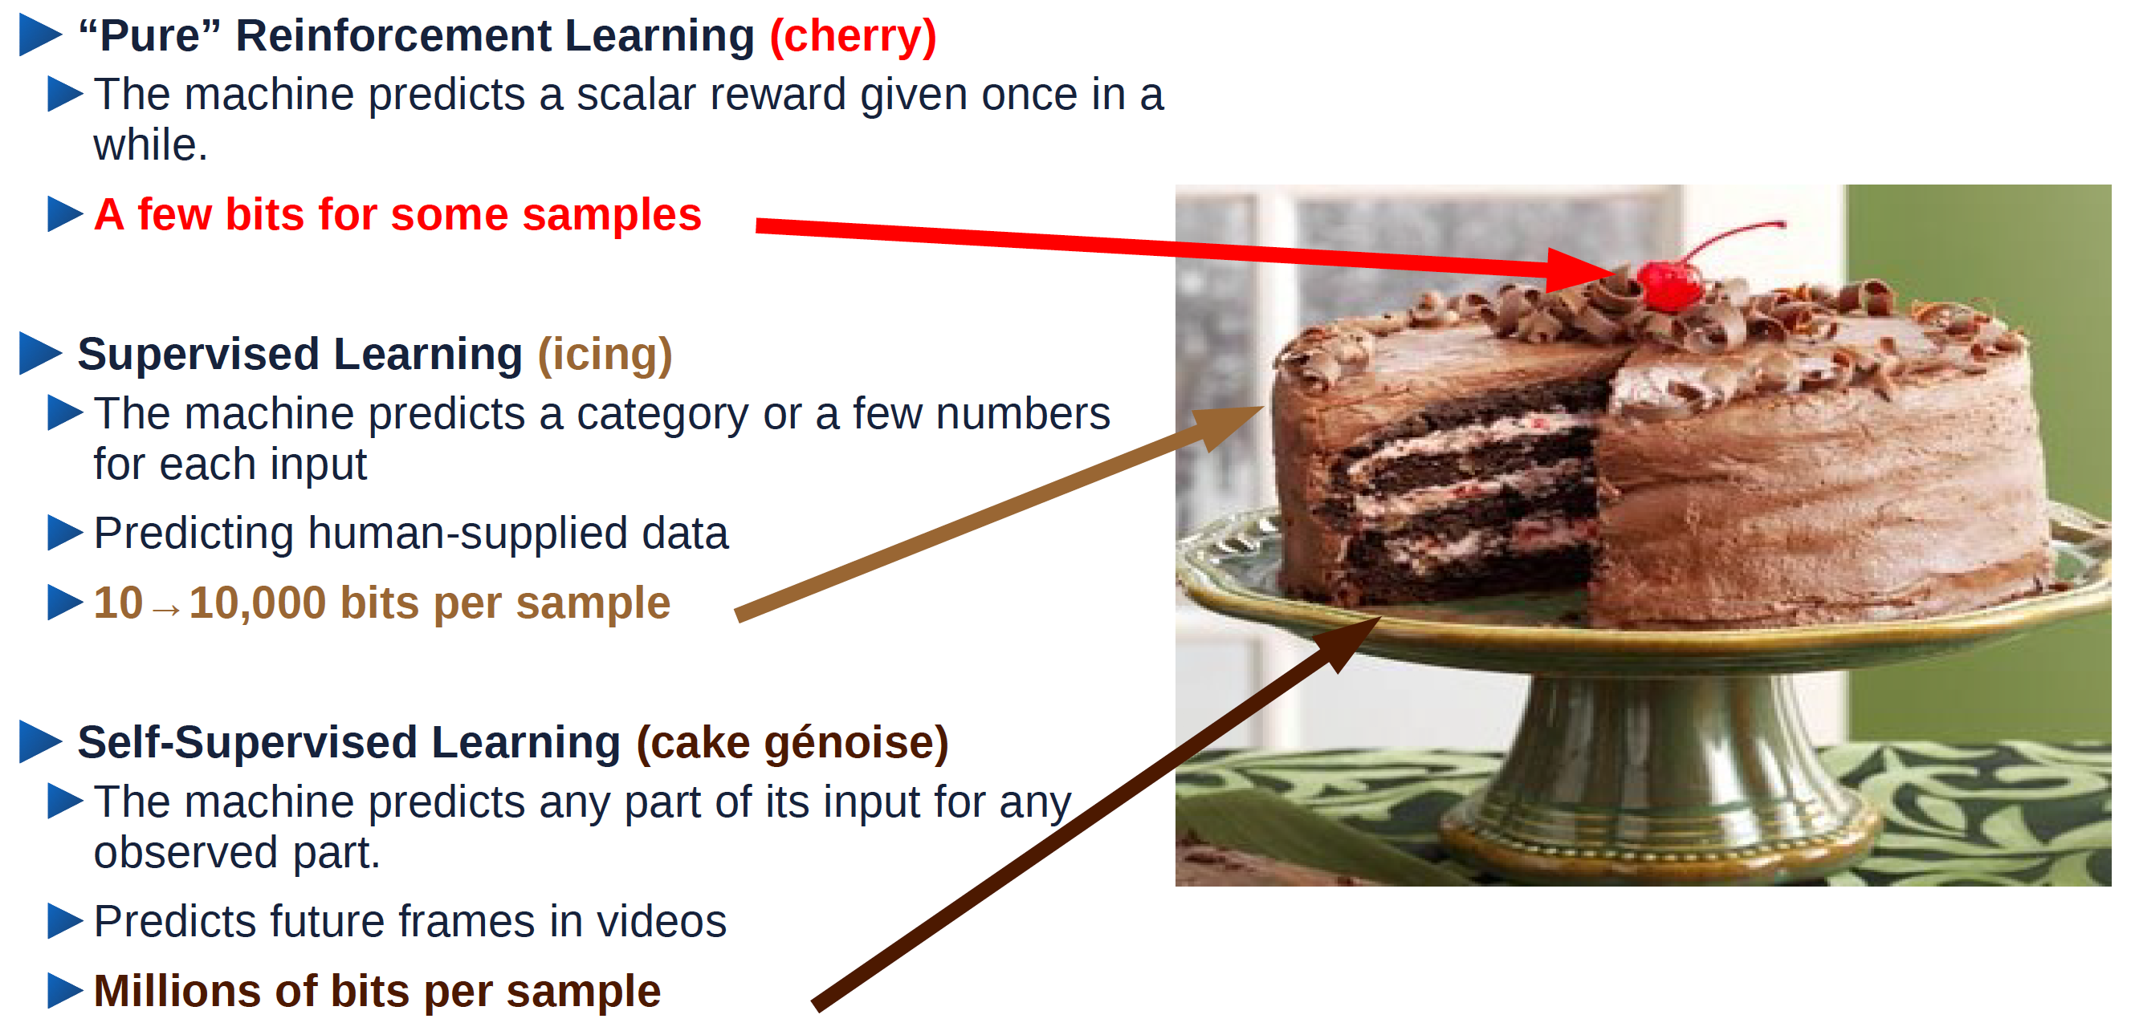
Three Types of Learning
Reinforcement Learning (Cherry)
The machine predicts a scalar reward given once in a while.
weak feedback: a few bits for some samples
Supervised Learning (Cream)
The machine predicts a category or a few numbers for each input
medium feedback: 10→10,000 bits per sample
Self-supervised Learning / Unsupervised Learning (Cake)
The machine predicts any part of its input for any observed part.
Predicts future frames in videos
A lot of feedback: millions of bits per sample
Notes:
In Reinforcement learning, feedback or scalar reward is weak, comparing with the category in supervised learning and parts of data in self-supervised learning.

Slide 4
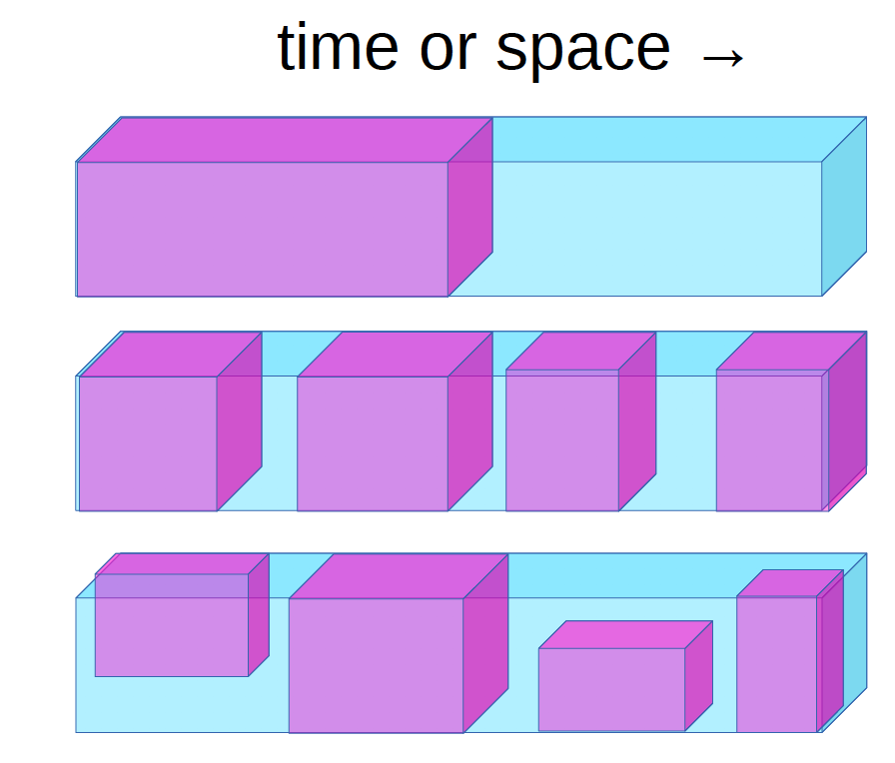
Self-supervised Learning
Predict any part of the input from any other part.
Predict the future from the past
Predict the masked from the visible
Predict the any occluded part from all available parts
Pretend there is a part of the input you don’t know and predict that.
Reconstruction = SSL when
any part could be known or
unknown
Notes:
Basically, in self-supervised learning, we could predict any part of the input from any other part.
e.g. vanilla auto-regressive model
language model, BERT,
In other words, in self-supervised learning, we pretend there is a part of the input we don’t know and aim to predict that.
One tradition way to do this is reconstruction, such as auto-encoder.

Slide 5
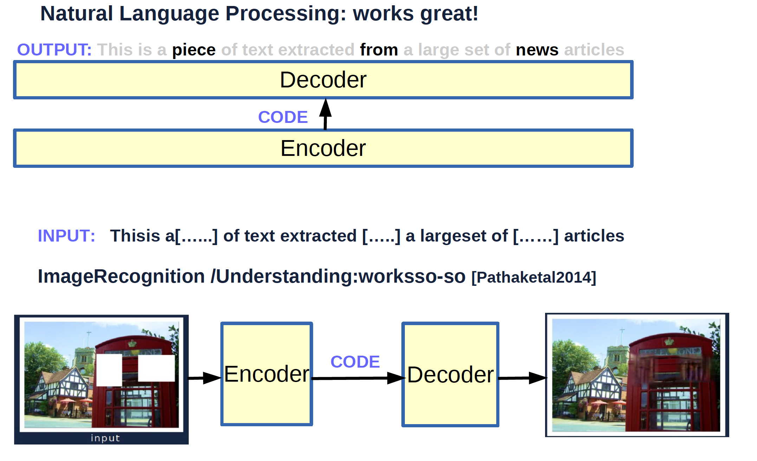
Reconstruction

Slide 6
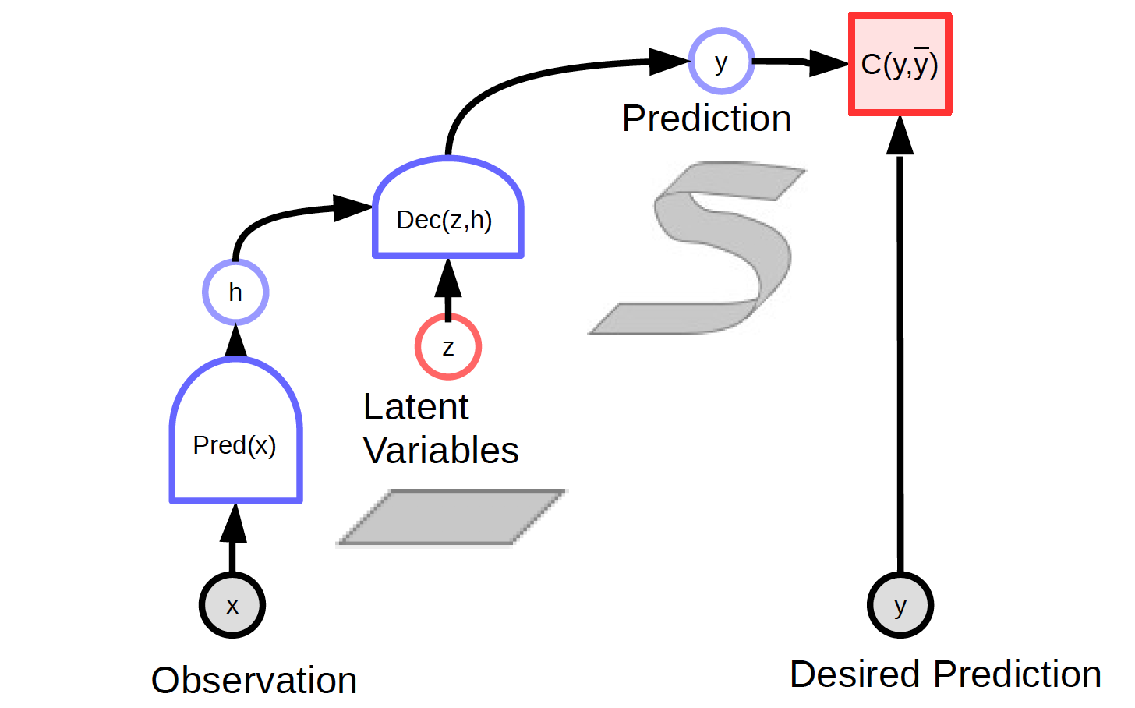
Self-supervised Learning
Latent representation allows system to make multiple predictions
Self-supervised learning
Downstream task
Notes:
In self-supervised learning, we aim to find a latent representation, which allows the system to make multiple predictions, or in other words, we want to find the generic pre-trained model that could be used for most downstream tasks.

Slide 7
Motivation of This Paper
Different from the mature techniques in supervised learning, unsupervised learning is yet to see a similar breakthrough.
Many challenges remain in unsupervised learning, such as data efficiency, robustness or generalization.
Many real-word datasets are unsupervised, thus making it important to model high-level representations.
Can we derive a generic pre-trained model that could be used for most downstream tasks?
Notes:
With these background in mind, we are ready to introduce this paper.

Slide 8
Outline
Introduction
Proposed Method
Structure
Formulation
Experiment
Conclusion

Slide 9
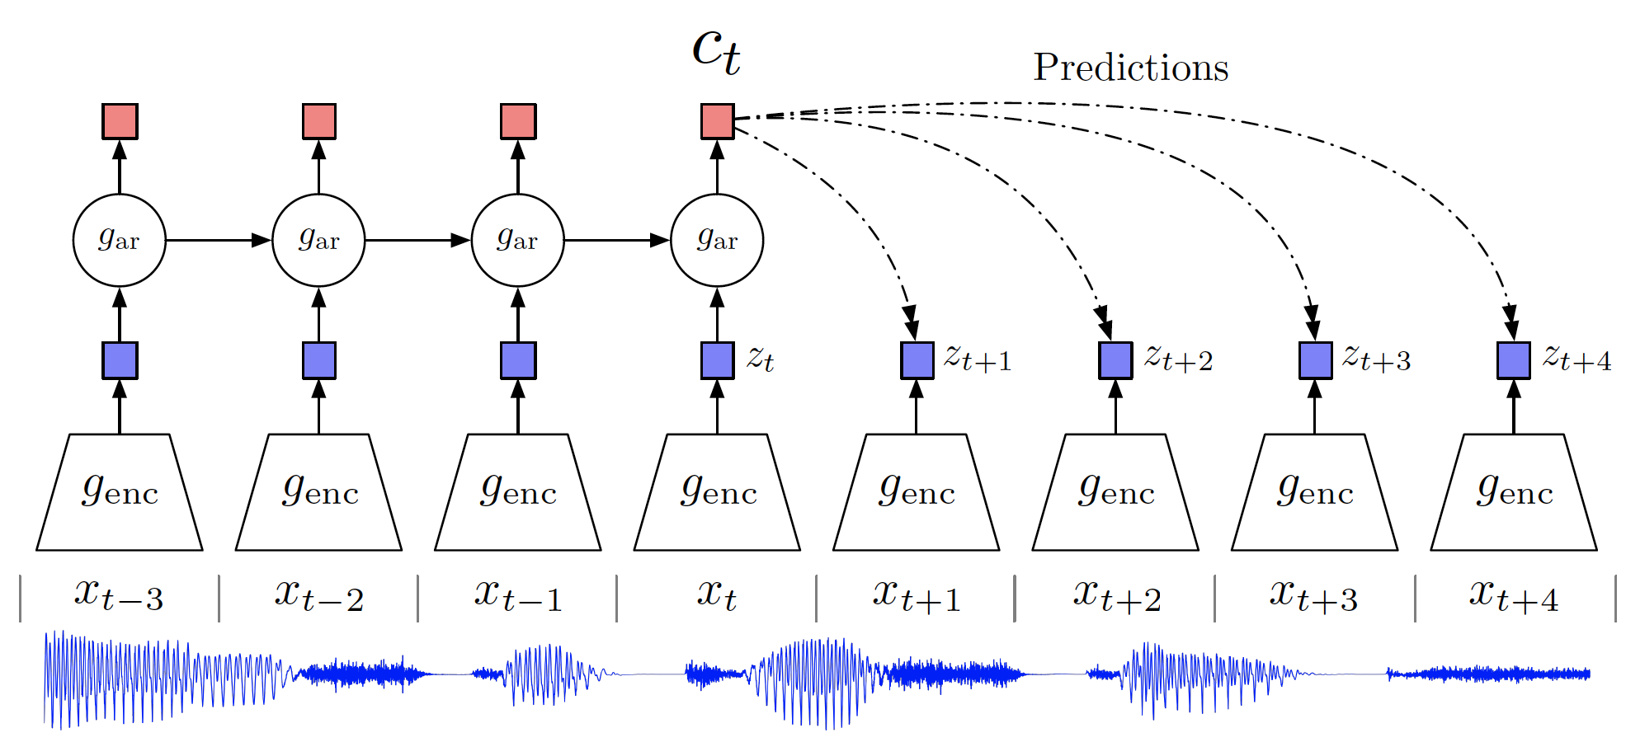
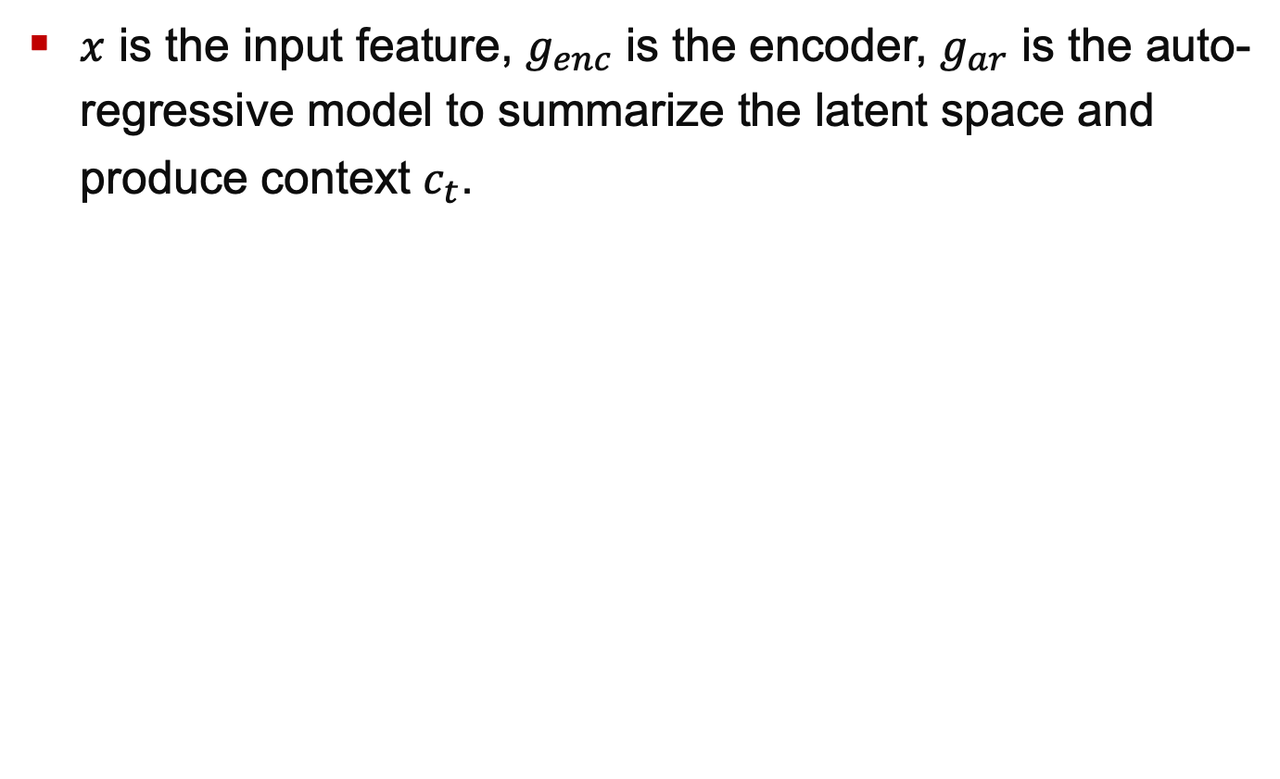
Overall Structure
$x$ is the input feature, $g_{enc}$ is the encoder, $g_{ar}$ is the auto-regressive model to summarize the latent space and produce context $c_{t}$.

Slide 10
Overview
What to Predict?
The authors use autoregressive models in this latent space to make predictions many steps in the future based on the past.
What is the label?
Future values in times series dataset; pixels in images.
Noise-Contrastive Estimation (Similar to Negative sampling).
E.g. In graph, positive sample: original graph; negative sample: corrupted (modified) graph.

Slide 11
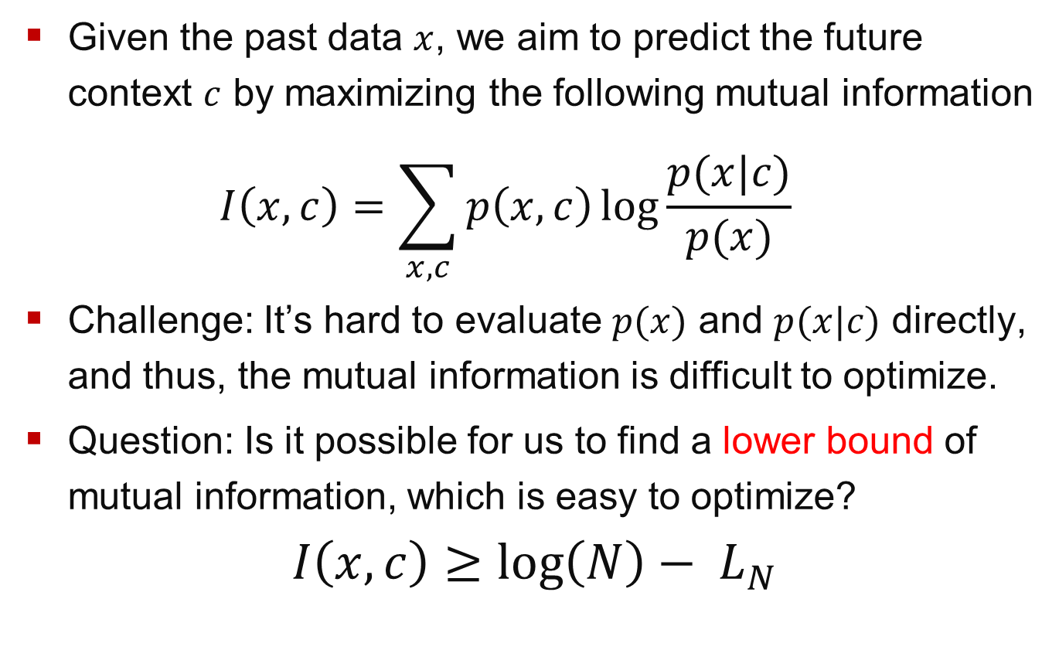
Mutual Information
Given the past data $x$, we aim to predict the future context $c$ by maximizing the following mutual information
$$I\left(x,c\right)=\sum_{x,c}{p\left(x,c\right)\log{\frac{p(x|c)}{p(x)}}}$$
Challenge: It’s hard to evaluate $p(x)$ and $p(x|c)$ directly, and thus, the mutual information is difficult to optimize.
Question: Is it possible for us to find a lower bound of mutual information, which is easy to optimize?
$$I\left(x,c\right)≥\log\left(N\right)− L_{N}$$
Notes:
Main idea of this paper is closed to the idea of mutual information.
Intuition: the distribution of the past should be similar to the distribution of the future.

Slide 12
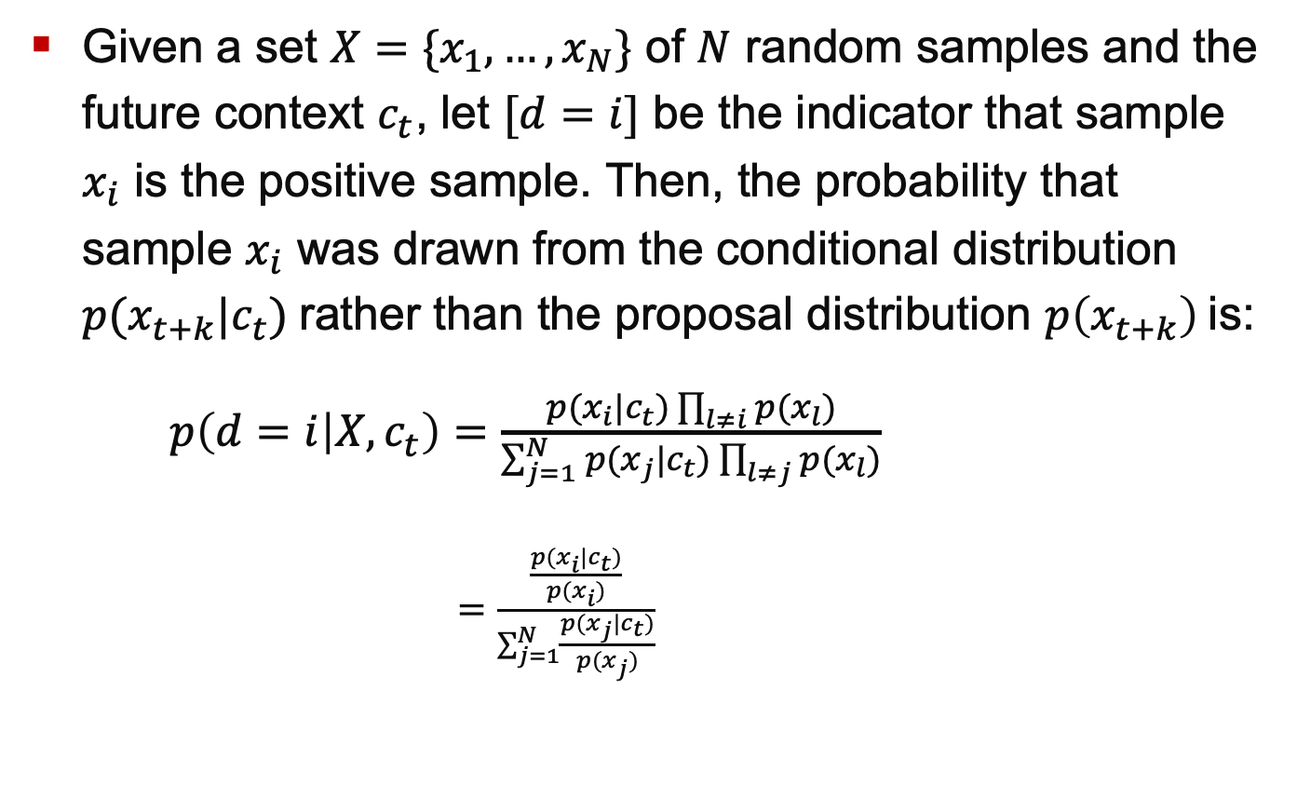
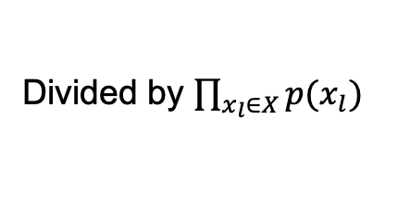
Notations
Given a set $X=\{x_{1}, …, x_{N}\}$ of $N$ random samples and the future context $c_{t}$, let $[d=i]$ be the indicator that sample $x_{i}$ is the positive sample. Then, the probability that sample $x_{i}$ was drawn from the conditional distribution $p(x_{t+k}|c_{t})$rather than the proposal distribution $p\left(x_{t+k}\right)$ is:
$p\left(d=i | X,c_{t}\right)=\frac{p(x_{i}|c_{t})\prod_{l≠i}{p(x_{l})}}{\sum_{j=1}^{N}{p(x_{j}|c_{t})\prod_{l≠j}{p(x_{l})}}}$
$=\frac{\frac{p(x_{i}|c_{t})}{p(x_{i})}}{\sum_{j=1}^{N}{\frac{p(x_{j}|c_{t})}{p(x_{j})}}}$
Divided by $\prod_{x_{l}∈X}{p(x_{l})}$

Slide 13
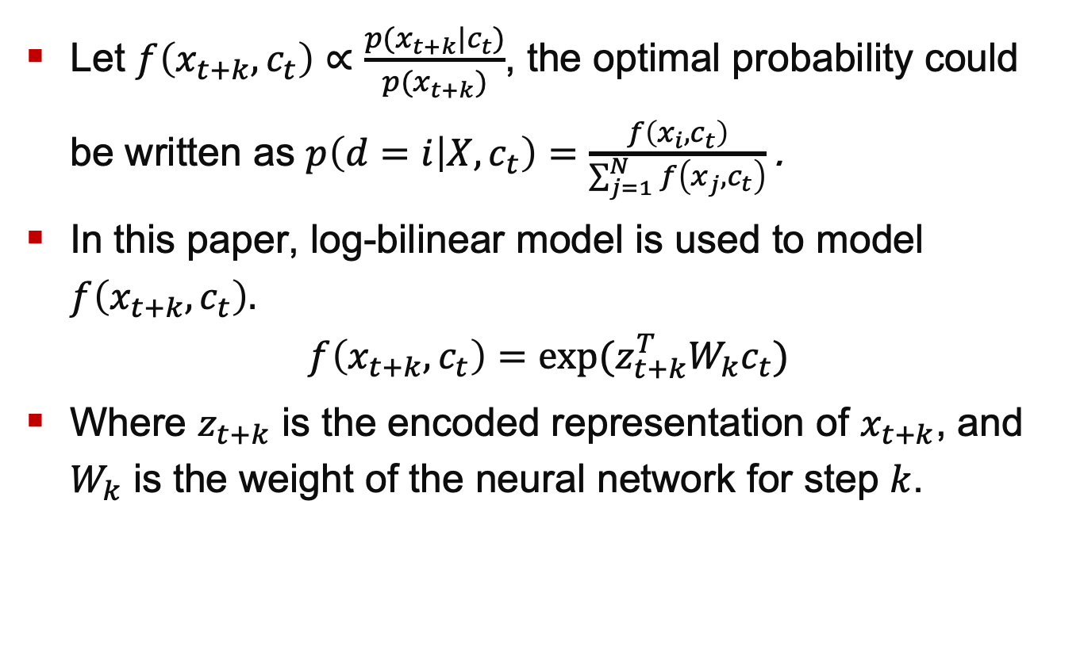
InfoNCE
Let $f\left(x_{t+k}, c_{t}\right)∝$ $\frac{p(x_{t+k}|c_{t})}{p(x_{t+k})}$, the optimal probability could be written as $p\left(d=i | X,c_{t}\right)=\frac{f\left(x_{i}, c_{t}\right)}{\sum_{j=1}^{N}{f\left(x_{j}, c_{t}\right)}}$ .
In this paper, log-bilinear model is used to model $f\left(x_{t+k}, c_{t}\right).$
$$f\left(x_{t+k}, c_{t}\right)=exp⁡(z_{t+k}^{T}W_{k}c_{t})$$
Where $z_{t+k}$ is the encoded representation of $x_{t+k}$, and $W_{k}$ is the weight of the neural network for step $k$.
Notes:
$f\left(x_{t+k}, c_{t}\right)$ could be considered as the non-liner transformation of dot product between $z_{t+k}$ and $W_{k}c_{t}$.
It measures how similar $z_{t+k}$ is to $c_{t}$.

Slide 14
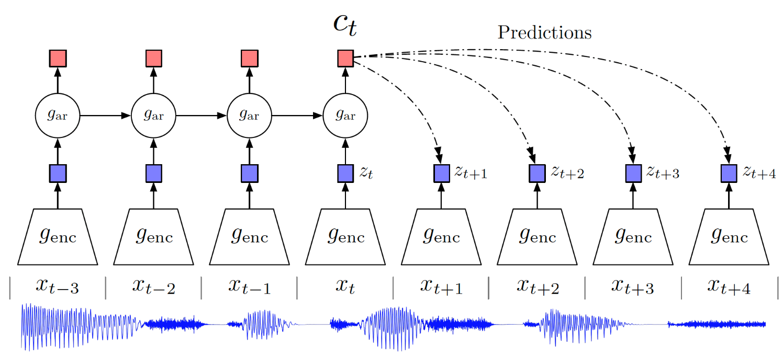
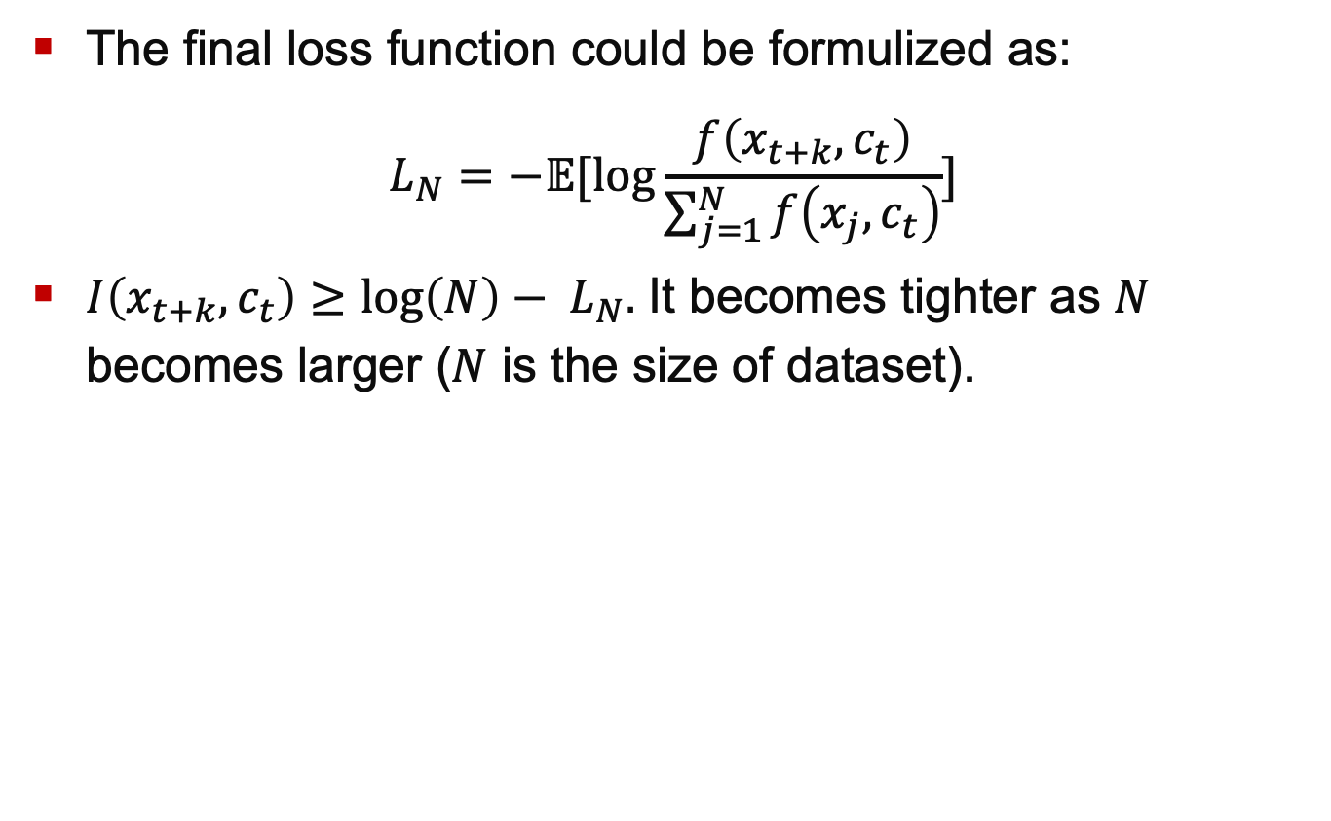
InfoNCE
The final loss function could be formulized as:
$$L_{N}=−𝔼[\log{\frac{f\left(x_{t+k}, c_{t}\right)}{\sum_{j=1}^{N}{f\left(x_{j}, c_{t}\right)}}}]$$
$I\left(x_{t+k},c_{t}\right)≥\log\left(N\right)− L_{N}.$ It becomes tighter as $N$ becomes larger ($N$ is the size of dataset).
Notes:
Intuition of loss function: in numerator, x_(t+k) is similar to c_t, then the value of f() should be large, in denominator, x_j is dissimilar to c_t, the value of f() should be small.

Slide 15
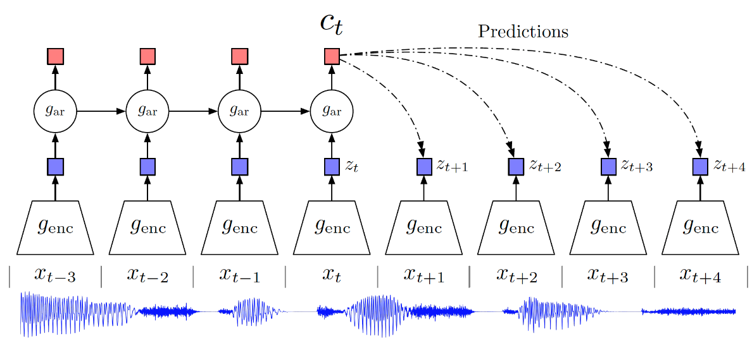
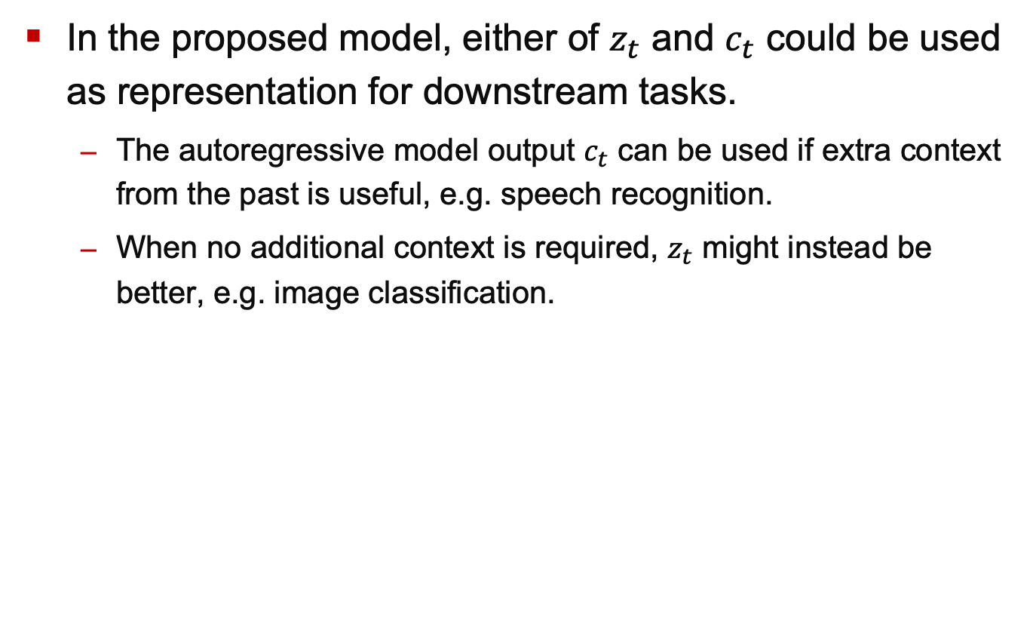
Learned Representation
In the proposed model, either of $z_{t}$ and $c_{t}$ could be used as representation for downstream tasks.
The autoregressive model output $c_{t}$ can be used if extra context from the past is useful, e.g. speech recognition.
When no additional context is required, $z_{t}$ might instead be better, e.g. image classification.
Notes:
In image classification, one can pool the representations from z_t over all locations.

Slide 16
Outline
Introduction
Proposed Method
Experiment
Conclusion

Slide 17
Experiment-Benchmarks
Audio
100-hour subset of LibriSpeech dataset
Images
ILSVRC ImageNet competition dataset
Natural Language Processing
movie review sentiment, customer product reviews, etc
Reinforcement Learning

Slide 18
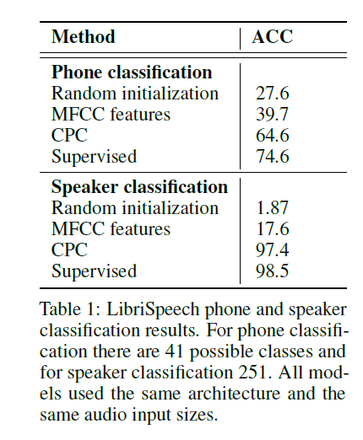
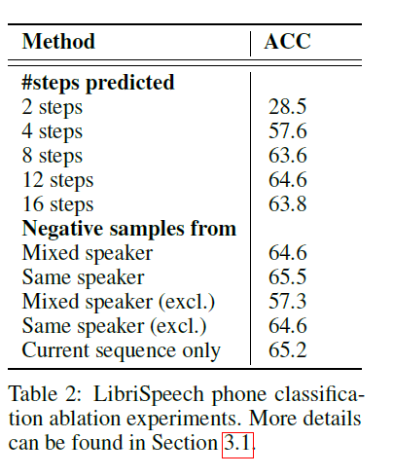
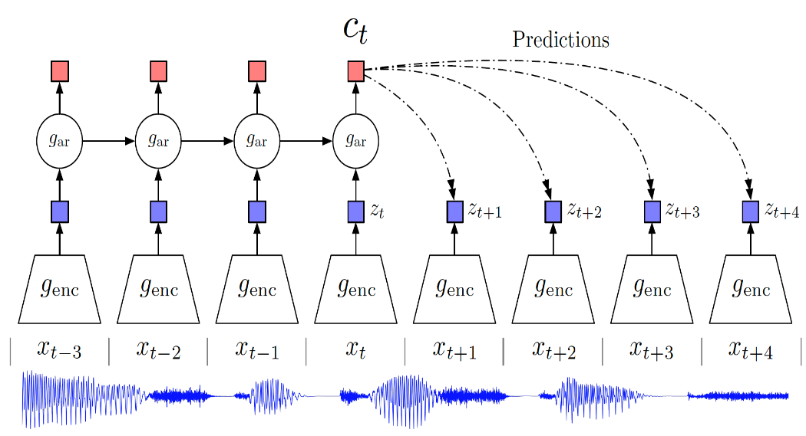
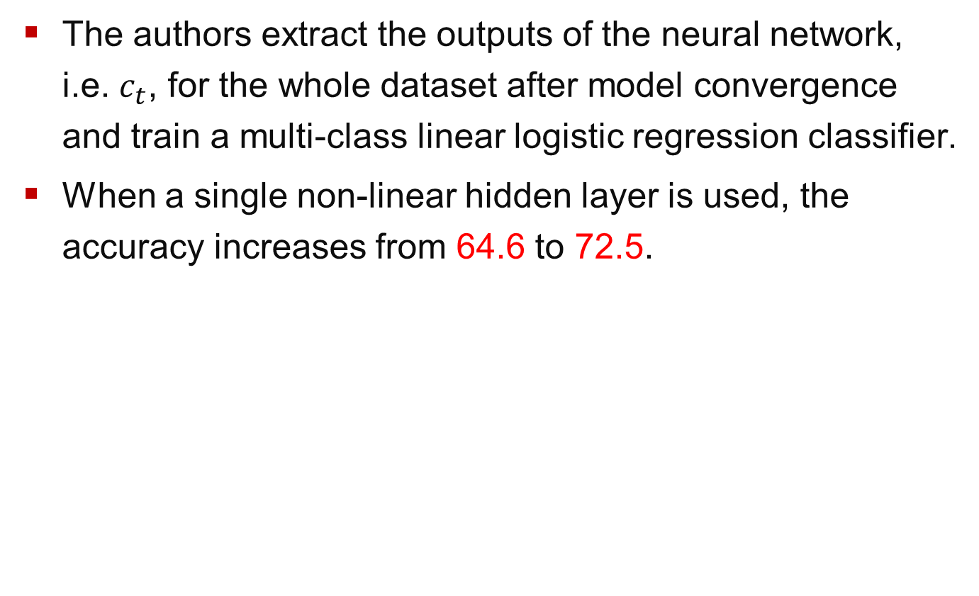
Audio
The authors extract the outputs of the neural network, i.e. $c_{t}$, for the whole dataset after model convergence and train a multi-class linear logistic regression classifier.
When a single non-linear hidden layer is used, the accuracy increases from 64.6 to 72.5.
Notes:
Regression model: future feature is the label

Slide 19
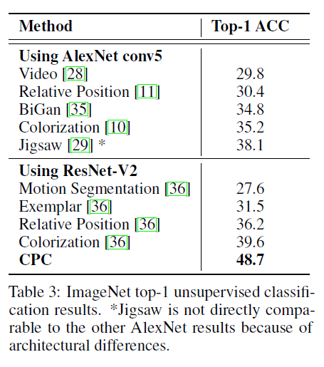

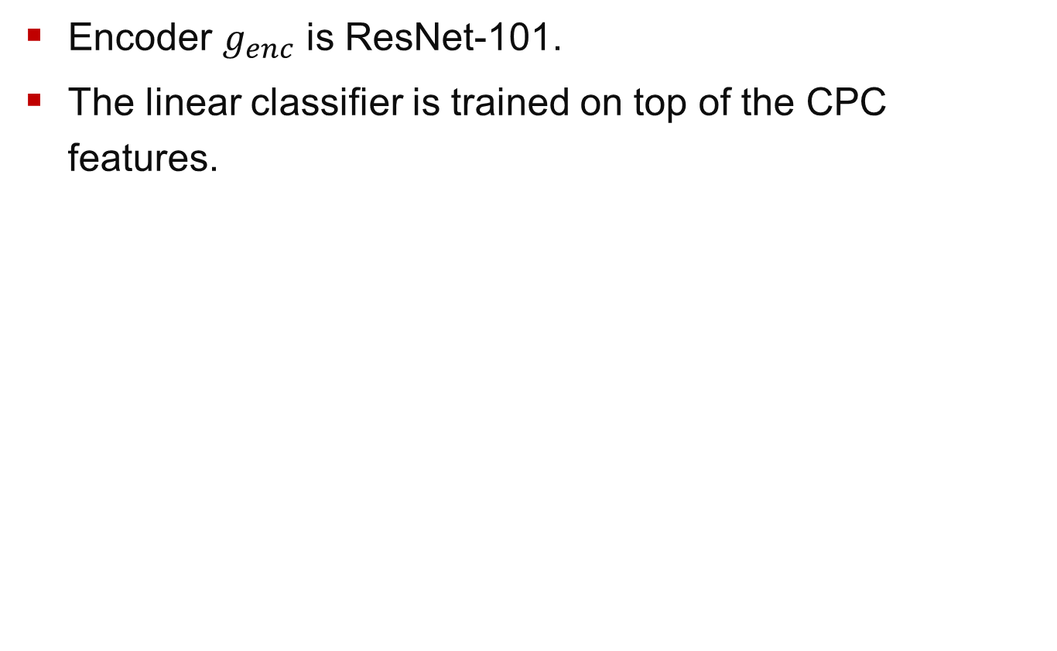
Image
Encoder $g_{enc}$ is ResNet-101.
The linear classifier is trained on top of the CPC features.
Prediction
Classifier

Slide 20
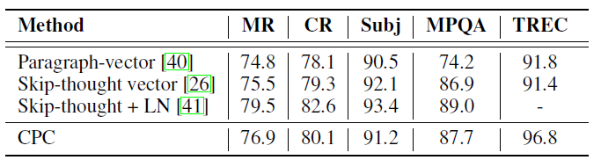
Natural Language Processing
They first learn our unsupervised model on the BookCorpus dataset , and then evaluate the capability of the model as a generic feature extractor by using CPC representations for classification tasks.
Tasks: movie review sentiment (MR), customer product reviews (CR), subjectivity/objectivity, opinion polarity (MPQA), question-type classification (TREC)
Notes:
Motivation: Can we train a generic pre-trained model that could be used for most downstream tasks?

Slide 21
Outline
Introduction
Proposed Method
Experiment
Conclusion
Other related work

Slide 22
Conclusion
This paper presented Contrastive Predictive Coding (CPC), extracting compact latent representations to encode predictions over future observations.
CPC is a powerful autoregressive model, aiming to make predictions many steps in the future based on the past.
They rely on Noise-Contrastive Estimation for the loss function, allowing for the whole model to be trained end-to-end.

Slide 23
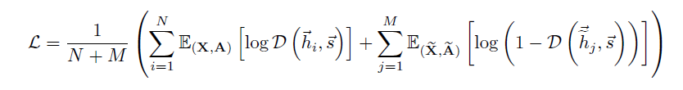
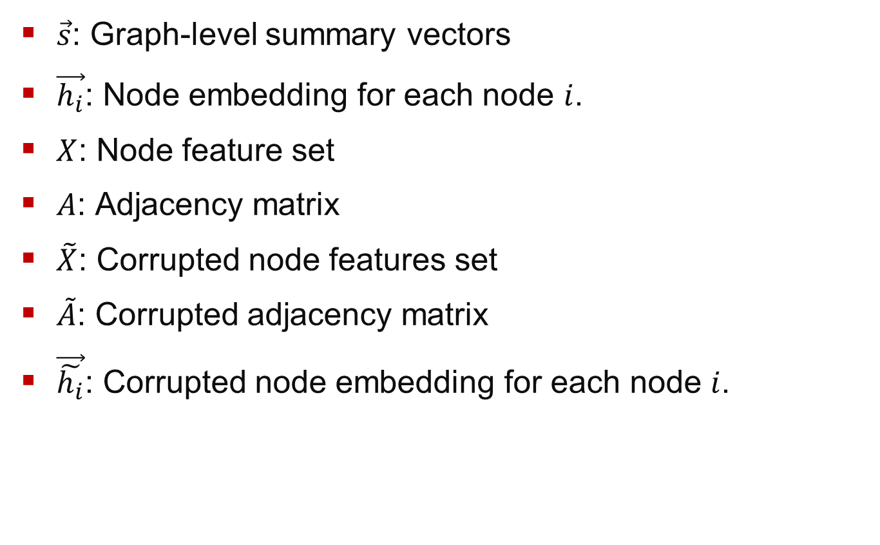
Deep Graph InfoMax
$\vec{s}$: Graph-level summary vectors
$\vec{h_{i}}$: Node embedding for each node $i$.
$X$: Node feature set
$A$: Adjacency matrix
$\tilde{X}$: Corrupted node features set
$\tilde{A}$: Corrupted adjacency matrix
$\vec{\tilde{h_{i}}}$: Corrupted node embedding for each node $i$.
Veličković, Petar, William Fedus, William L. Hamilton, Pietro Liò, Yoshua Bengio, and R. Devon Hjelm. "Deep graph infomax." arXiv preprint arXiv:1809.10341 (2018).

Slide 24
More Related Paper
Pre-Training Graph Neural Networks for Generic Structural Feature Extraction
Deep Graph Infomax
Strategies for pre-training graph neural networks
A Simple Framework for Contrastive Learning of Visual Representations
Momentum Contrast for Unsupervised Visual Representation Learning
Self-Supervised GANs via Auxiliary Rotation Loss

